Slide 1
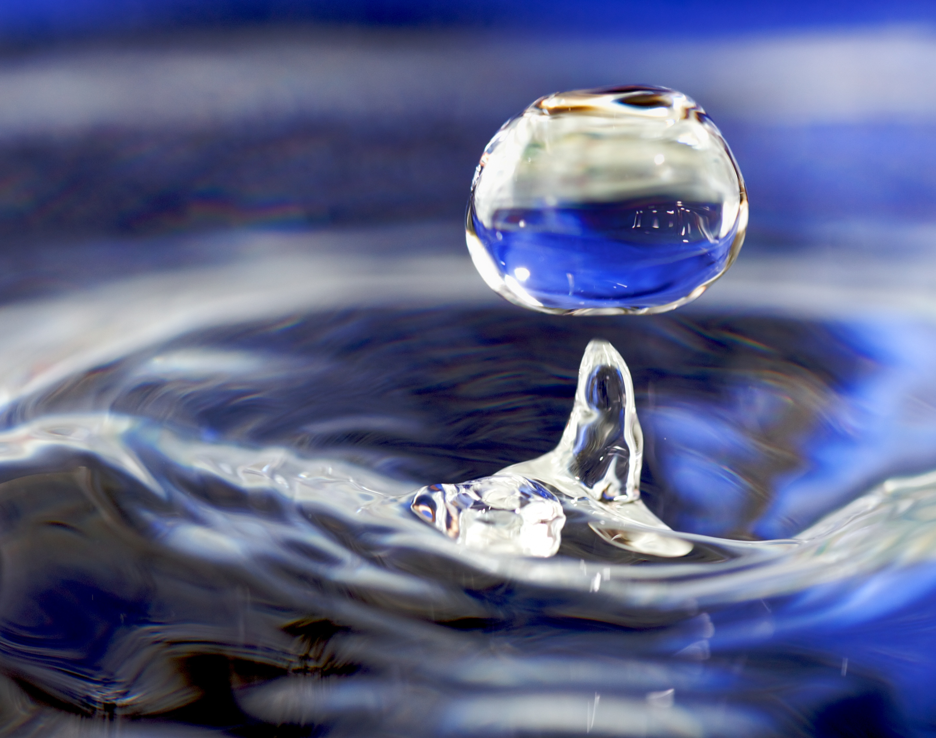
WATER POLLUTION MONITOR
M.VARSHITHA -B22IN027
This Photo by Unknown author is licensed under CC BY-SA.

Slide 2
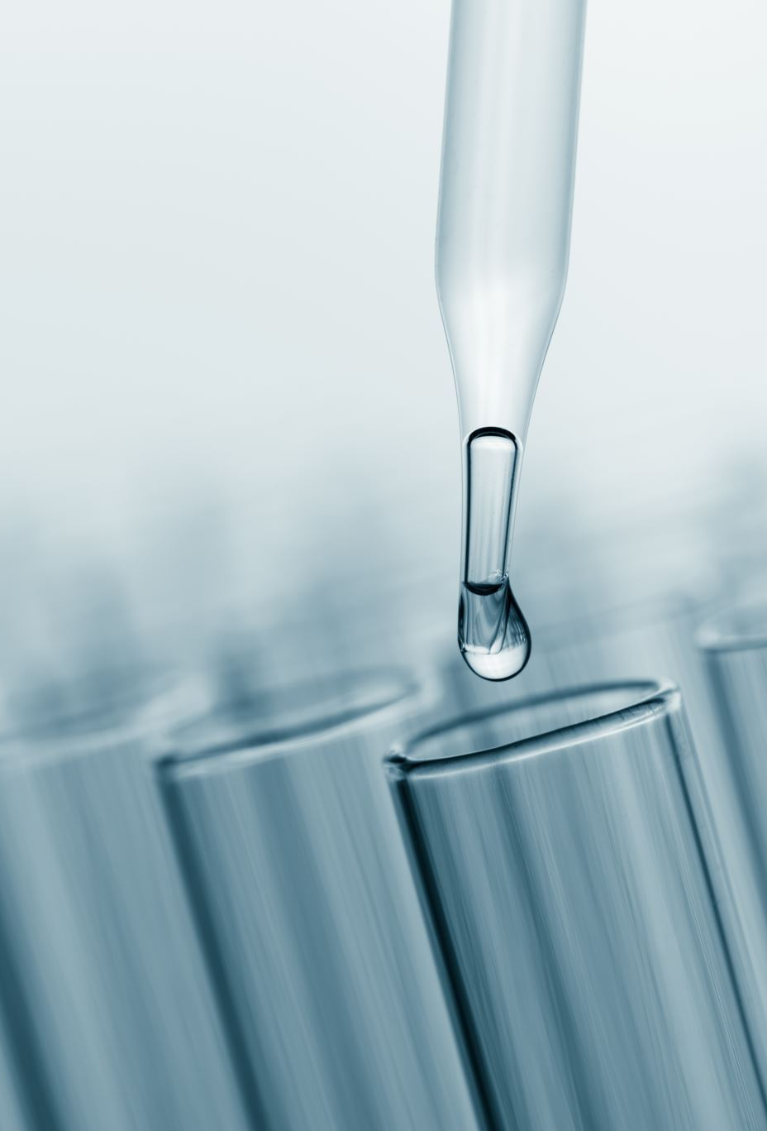
INTRODUCTION
Water quality plays an important role in the health of animals and human beings.
The first step towards water pollution control is to be able to monitor the actual level of water pollution.
So we here design a solution for easy water quality checking of vast water bodies with ease.
This project mainly focuses on monitoring the dissolved solids and the turbidity level of water.

Slide 3
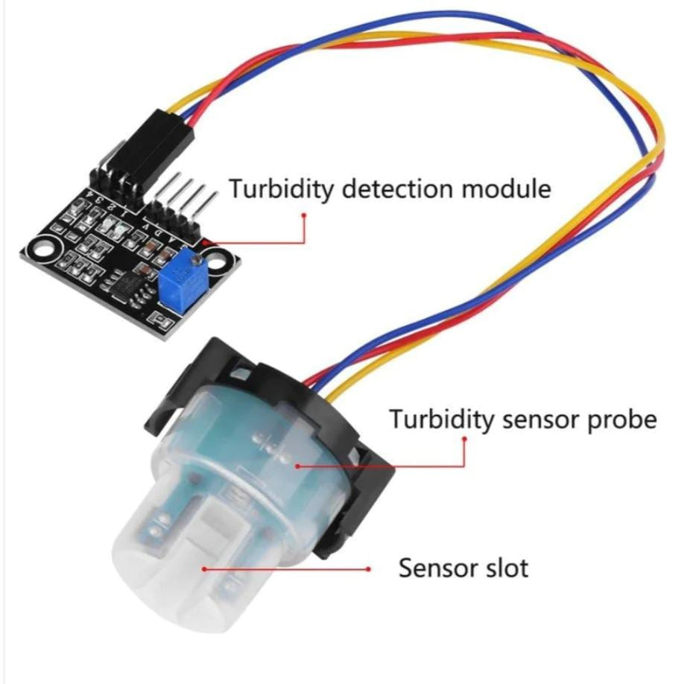
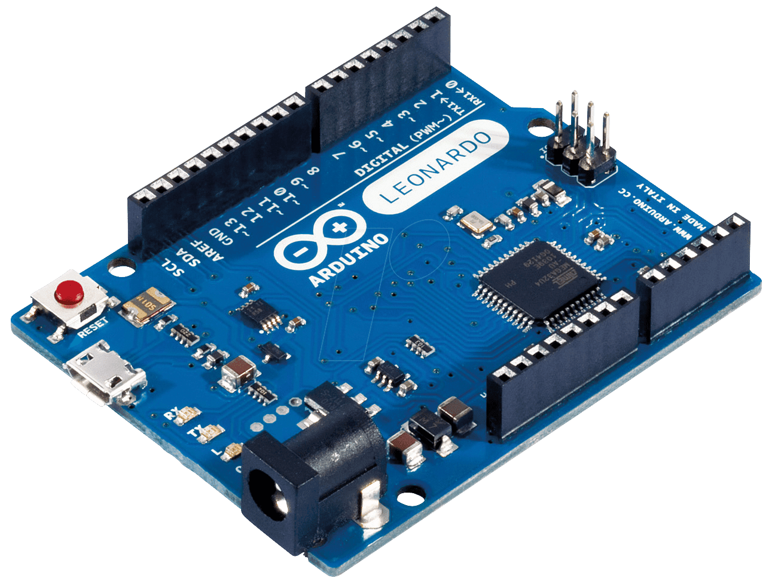
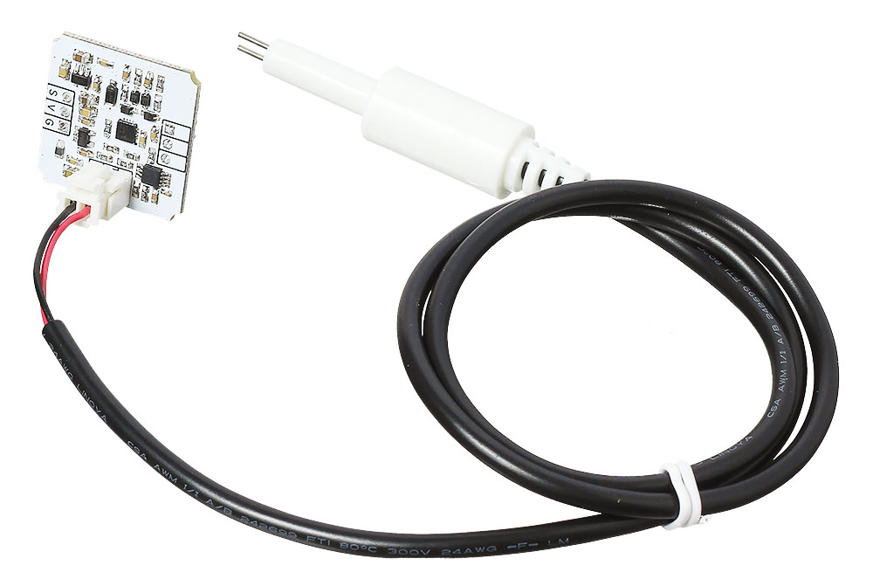
Requirements:
Hardware requirements: Software:
TDS sensor(Total dissolved solids) Arduino IDE
Turbidity sensor
Bread board
Arduino
Jumper wires

Slide 4
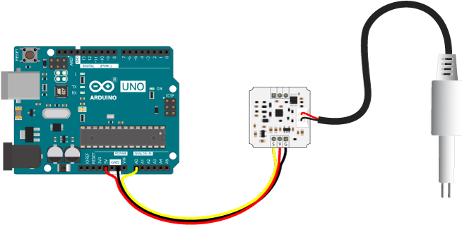
TDS SENSOR:
TDS Total Dissolved Solids meter measures the number of total dissolved solids like salts, minerals, and metals in the water.
PRINCIPLE:
As the number of dissolved solids in the water increases, the conductivity of the water increases, and that allow us to calculate the total dissolved solids in ppm (mg/L)
So the higher the TDS value, the more soluble solids are dissolved in water, and the less clean the water is.
RANGE
0-150 | Excellent(distilled/Highly purified)
150-400 | Good for drinking purposes
400-800 | Mildly polluted
Above 800 | toxic
This Photo by Unknown author is licensed under CC BY-SA-NC.

Slide 5
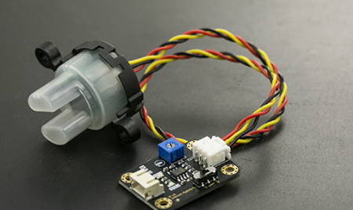
TURBIDITY SENSOR
It detects water quality by measuring the levels of turbidity, or the opaqueness.
PRINCIPLE:
When light passes through a certain amount of water, the amount of light penetration depends on the amount of dirt in the water.
As the amount of dirt increases, the light that penetrates the water sample decreases, and the turbidity sensor measures the amount of light transmitted to calculate the turbidity of the water.
Range(volts)
4-4.5 | Clean water
3-4 | Good (partially contains impurities)
1-3 | Mildly polluted
0-1 | toxic

Slide 6

INTERFACING TDS AND TURBIDITY WITH ARDUINO
For TDS sensor:
Connect VCC to 5V on Arduino.
Connect GND to GND on Arduino.
Connect the analog output to an analog pin on Arduino.
For Turbidity sensor:
Connect VCC to 5V on Arduino.
Connect GND to GND on Arduino.
Connect the signal or analog output to another analog pin on Arduino

Slide 7
OVERVIEW OF MODULE & RESULTS:
TDS sensor and turbidity sensor are interfaced with arduino.
When this module is placed in the water body the voltage values from turbidity sensor and dissolved particles content(in ppm) are recorded.
These voltage and ppm values are analyzed and the purity level of water is displayed
This purity level of water gives conclusions on the major issues like:
The aquatic life possibility
Can/cannot be used as a drinking water source
The toxicity level etc.

Slide 8
TARGETS OF THE PROJECT:
Water bodies pollution Monitoring
Fish farm monitoring
Cost Efficiency
Raises public awareness by sharing
real-time data on water quality.
Early Detection
ITEMS | BUDGET
TDS SENSOR | 1100
TURBIDITY | 900
ARDUINO UNO | 600
JUMPER WIRES | 20
BREAD BOARD | 60

Slide 9
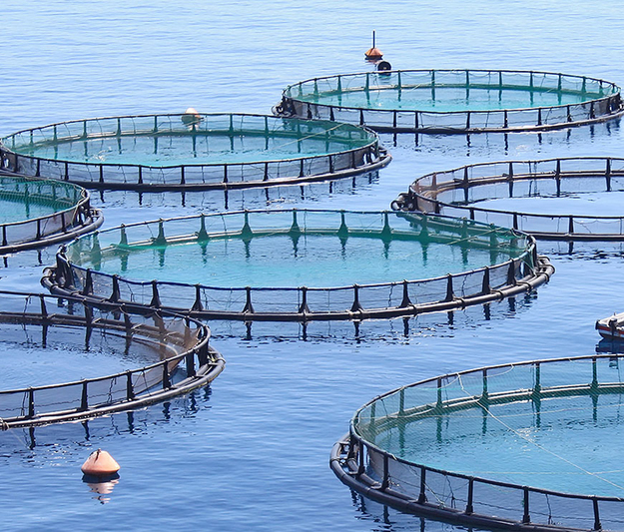
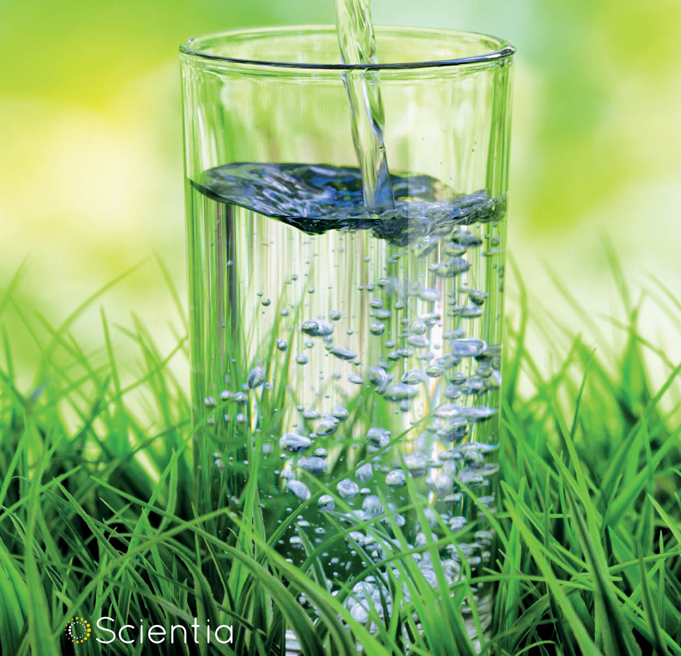
CONCLUSION:
This project helps the government in many ways
FISH CULTURE
Without testing the purity and tds levels of water, fish cultivation can become hazardous. The aquatic life cannot sustain and the fish when consumed can cause health hazards.
PURIFICATION:
For water purification this data is important. For less polluted water if high purification is done it can make the water loose all the minerals.
AGRICULTURE:
The minerals and chemicals of water can turn the food produced into poison.so it is important to check the water purity level .

Slide 10

Any doubts...

Slide 11


